Slide 1
Orthographic Projection
Introduction

Slide 2
Expected learning outcomes
By the end of the lesson, you should be able to :
Identify and differentiate between the various views in orthographic projection
Draw accurate orthographic projections from 3D objects, ensuring precision in dimensions and details.
Read and interpreting orthographic drawings, display the relationship between different views and the 3D object.
Apply orthographic projection techniques to solve real-world problems, creating detailed technical drawings for engineering and architecture.

Slide 3
Note to the learner
The figures used in this lesson are colored for the sake of visualization to better elaborate the concepts.do not apply colour to your drawings if you are using CAD software.do not shade your drawings if you are drawing by hand manually.

Slide 4
Orthographic projection
Orthographic projection is a method of representing three dimensional objects usually by three two-dimensional drawings in which each parallel line is drawn parallel to the plane of view

Slide 5
Orthographic projection
1
5
2
Consider the figure on the right
What do you see if you are directly at the positions 1,2,3,4 and 5
4
3

Slide 6
View 1
View 2
View 5
View 4
View 3

Slide 7
Orthographic projection
There are two separate methods of drawing in orthographic projection. These are the first angle projection and the third angle projection. The latter method is becoming more popular throughout the world, and may soon become the only accepted System in drawing
At present, in Kenya we use both methods. The building industry mostly uses the first Angle projection while the other engineering trades prefer third angle projection.
Consequently, the learner should be well conversant with both these methods and their differences
The names first angle and third angle are derived from mathematics. A circle is divided to four right angles thus forming four equal quadrants. The first angle is from 0⁰ to 90⁰ in the first quadrant and the third angle is from 180⁰ to 270° in the third quadrant.

Slide 8
Orthographic projection
90⁰
II
I
180⁰
0⁰
III
IV
270⁰

Slide 9
Orthographic projection
Consider the cube on the right
With the planes at right with the faces
If the cube is to be viewed from the top the blue square will be seen on the top plan, a red one on the side to the right and a yellow square on the square of the face on the left
This is demonstrated in the figure below.
Notes:
Using inventor place planes on the cube and explain

Slide 10
Orthographic projection
Top
End
Front

Slide 11
Orthographic projection
Orthographic projection is so important not just because several views of the same object can be drawn but because the views are linked together
To obtain the views then the 3D object is imagined to be suspended between planes, where a plane is a perfectly flat surface
The view used in orthographic projection are the top view(plan),the front view the side (or end) view, sectional views (and auxiliary views in various situations)
The front elevation displays the H and L
The end elevation displays the W and H
The plan elevation displays the L and W
The views can also be referred to as elevations

Slide 12
orthographic projection
Orthographic projection overcomes the drawbacks of difficulty of drawing circles and curves on 3-sided objects due to its flexibility in allowing any number of views of the same object
Forms of orthographic projection
First angle orthographic projection
Third angle orthographic projection
The actual views drawn in both methods are exactly the same the only being the position of the view(orientation)

Slide 13
3rd angle orthographic projection
The object is place in the third quadrant.
All three views are linked together: the plan is directly above the Front Elevation; the End Elevation is horizontally in line with the Front Elevation; and the plan and the End Elevation can be linked by drawing 45° projection lines.(miter line or deflector)
Lines from selected points on the object are drawn to meet the various planes at right angles .the line projected to the plane and the other surface are called projectors or projection lines
Note that with third angle projection, what you see from the left you draw on the left, what you see from the right you draw on the right and what you see from above you draw above.
Below is the format

Slide 14
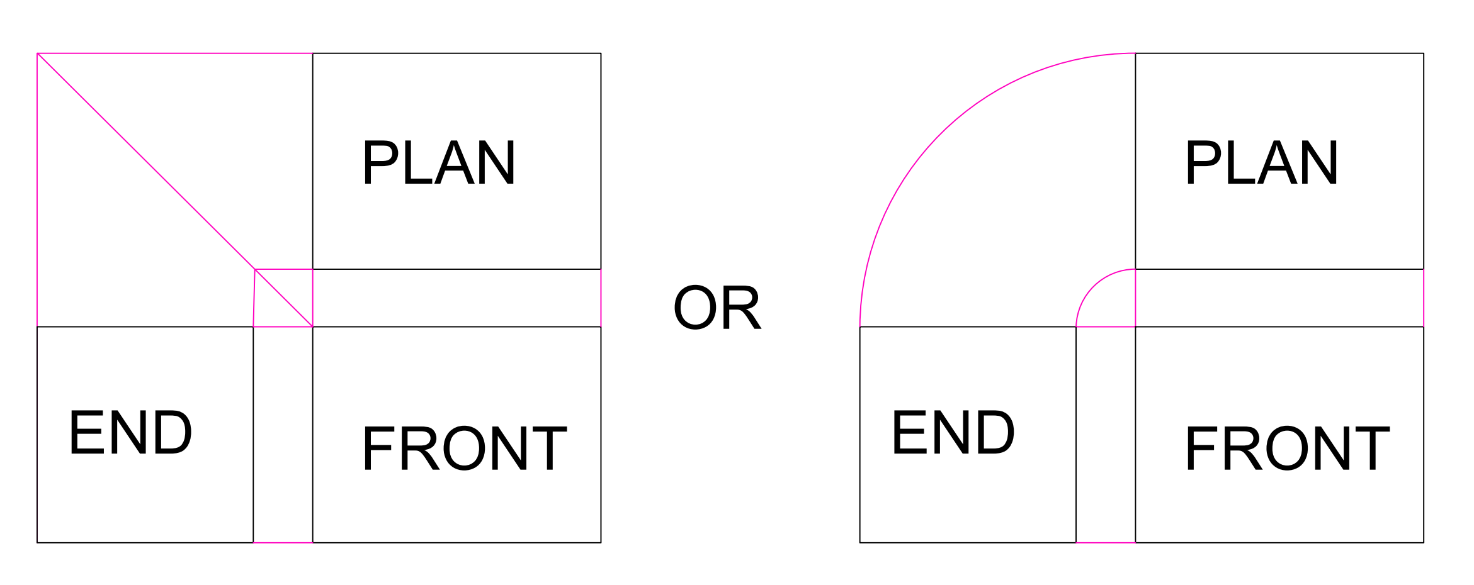
Third angle Projection layout
Deflector or Miter line

Slide 15
Note do not draw two end elevations(yellow). Draw one depending on the side where the end is stated in the provided problem.
Notes:
The yellow face is on the right in this case because the end face was on the left side. Remember that for third angle

Slide 16
Example

Slide 17
Example

Slide 18
Example
Cylindrical or circular features only need two elevations to be fully represented. However, with these features we introduce center marks on the circle and center lines on the rectangular feature of the discussed.

Slide 19
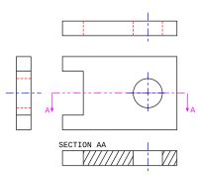
Centre line and center marks
The blue line in all the rectangular features are the center lines. Represented by a long dash then a shorter dash
The blue + sign is the center mark and has to be place on all circles
This Photo by Unknown Author is licensed under CC BY-SA

Slide 20
Example
Hidden details have not been shown. They will be discussed. Below

Slide 21
Third angle projection
Note that in all the above examples the end was on the right of the observer hence it was projected on the left for the case of third angle projection

Slide 22
Selection criteria for front elevation when not specified
If the front and end are not specified then the front should be the side with the most features or the longest side

Slide 23
1st angle orthographic projection
The plan is directly below the Front Elevation; the End Elevation is horizontally in line with the Front Elevation; and the plan and the End Elevation can be linked by drawing 45° projection lines.
Note that with first angle projection, what you see from the left you draw on the right, what you see from the right you draw on the left and what you see from above you draw below.
Below is the general layout:

Slide 24
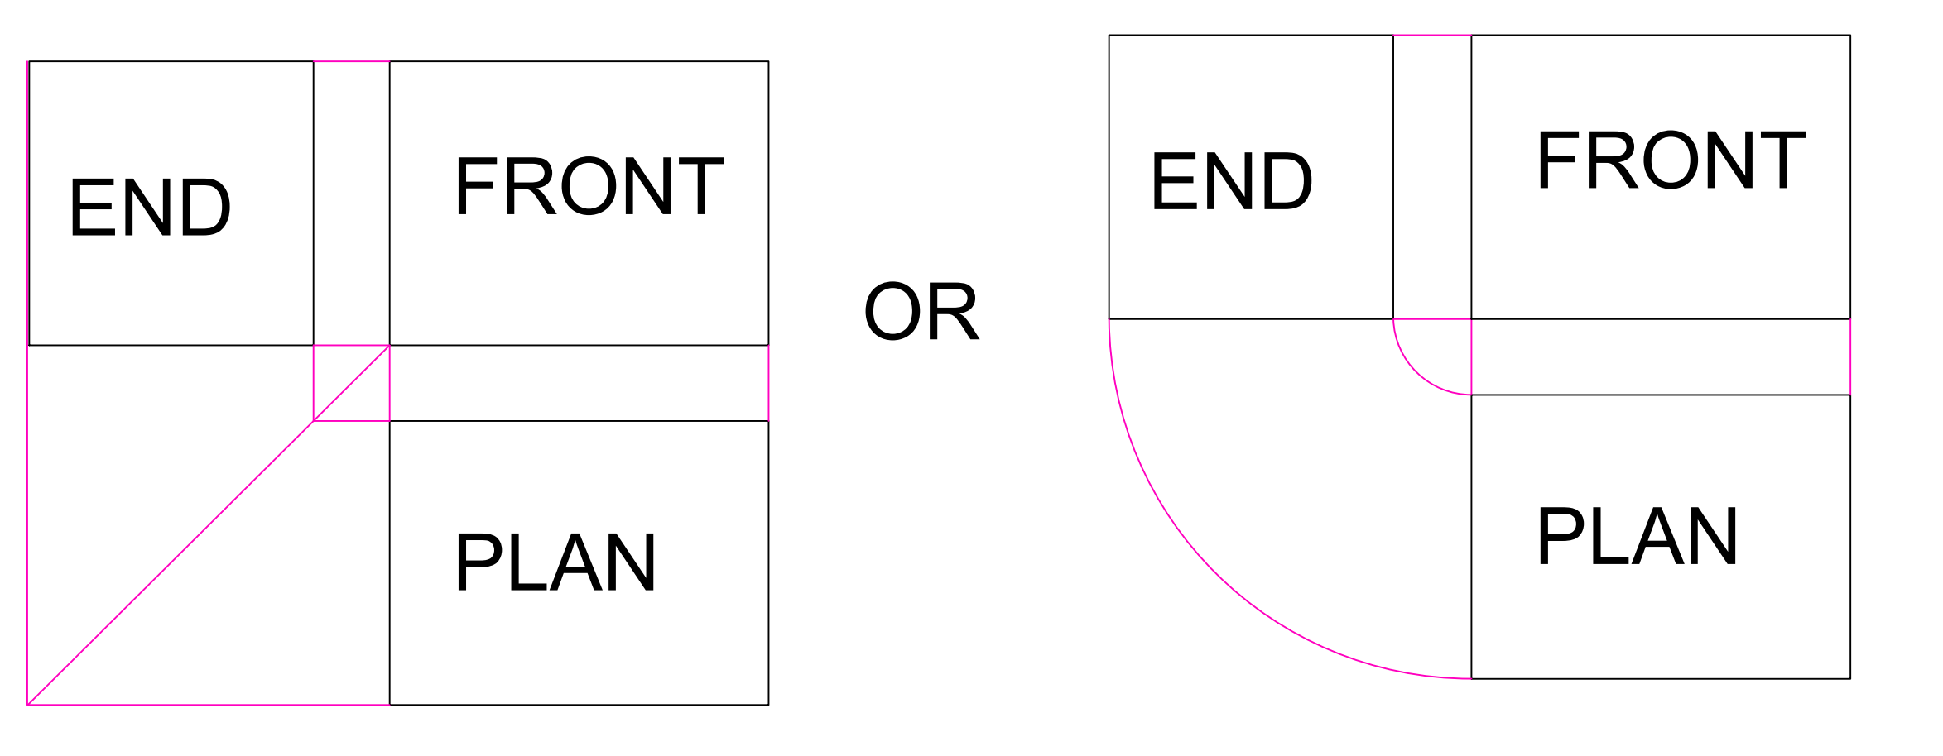
First angle projection layout

Slide 26
Example

Slide 27
Example

Slide 28
Example

Slide 29
Example
Cylindrical or circular features only need two elevations to be fully represented. However, with these features we introduce center marks on the circle and center lines on the rectangular feature of the discussed.

Slide 30
Example
Hidden details have not been shown. They will be discussed. Below

Slide 31
Differences between 1st angle orthographic projection and 3rd angle orthographic projection
1st angle orthographic projection | 3rd angle orthographic projection
The object is kept in the first quadrant. The object lies between the observer and the plane or projection. The plane of projection is assumed to be non-transparent. In this method, when the views are drawn in their relative positions,· the plan comes below the front elevation, the view of the object as observed from the left-side is drawn to the right of elevation. | The object is assumed to be kept in the third quadrant. The plane of projection lies between the observer and the object. The plane of projection is assumed to be transparent. In this method, when the views are drawn in their relative positions, the plan, comes above the front elevation, left hand sideview is drawn to the left-hand side of the front elevation.

Slide 32
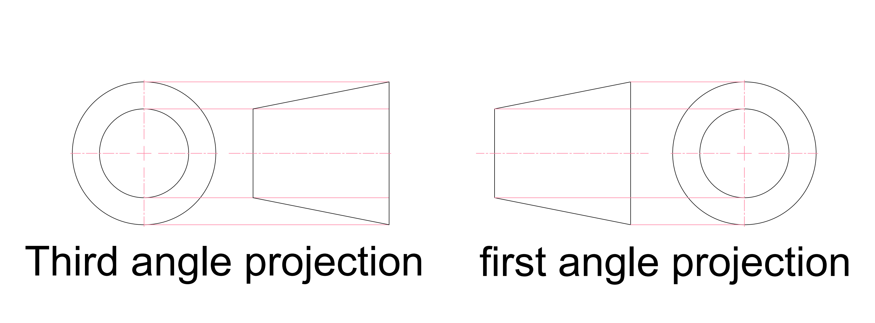
Projection symbols
It is good practice to indicate the method of projection used in your drawings. This enables the other engineers or the technician producing the part to easily distinguish the plan from the front drawings. This are the symbols used to represent the methods of projection

Slide 33
Derivation of the symbols(3rd angle projection)
The symbols are obtained from the views of a conical frustrum
or

Slide 34
Derivation of the symbols(1st angle projection)
The symbols are obtained from the views of a conical frustrum
or

Slide 35
Hidden line in orthographic projection
The other advantage of orthographic projection over the pictorial drawing methods is that hidden details can be conveyed accurately and clearly.
Hidden details are represented by short dashes that should be approximately equal
-------------------------------------

Slide 36
Hidden details notes
Hidden lines are used in engineering drawings to represent features that cannot be seen in a particular view but are necessary to fully define the part or assembly. These features are typically inside the object or obscured by other surfaces
Although hidden lines are sometimes necessary to add clarity and reduce the number of views required on a drawing, they should be omitted whenever they don’t add needed information to the drawing. The presence of too many extra hidden lines make drawings harder to interpret or read. Hidden lines are not required on assembly drawings, and they should be omitted from auxiliary views whenever possible.
Hence the need for sectional views(will be discussed in detail in working or assembly drawings)
Generally hidden lines can be omitted when they are not required for clarity. A note can be included to indicate that hidden lines are omitted.

Slide 37
Important lines used in orthographic projection

